Slide 1
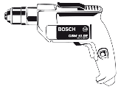
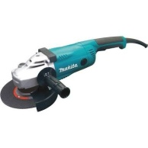
Basic power tools and manual machines.
1. Electric Hand Drill
- It is used for drilling holes on metals.
2. Angle Grinder
- It is used for cutting and grinding metals.

Slide 2
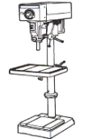
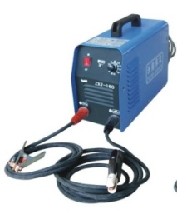
Basic power tools and manual machines (continues)
3. Drill Press
- It is used for drilling holes on metals and on sheet metals.
4. Arc Welding
- It is used for joining metals.

Slide 3
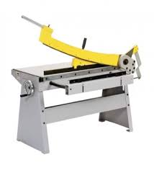
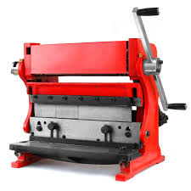
Basic marking cutting hand tools.
5. Guillotine
- It is used for cutting sheet-metals.
6. Bending Brakes
- It is used for bending sheet-metals.

Slide 4
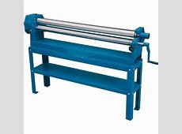
Basic marking cutting hand tools.
7. Horizontal rollers
- It is used for rolling sheet-metals.
Method of joining Metals
1. Arc welding
2. Riveting
3. Gas welding
4. Soldering
5. Screws
Video :
https://youtu.be/2JH2f4ytqEI?si=nUgcPAuwGgSDvLUg
Feedback : Activity

Slide 5
Kwa Thema Skills School
Subject : Maintenance Marks : 12
Grade : Year 1 Time : 30 mins
Date : / / 2024
Question:1
Name the following marking and cutting hand tools.
1.__________________ 2.______________________
3.___________________ 4. ______________________

Slide 6
5. ___________________________ 6. ____________________
7. ___________________________
Question:2
2. Name five joining methods
1. ___________________
2. ___________________
3. ___________________
4. ___________________
5. ___________________
(5)

Slide 7
Question:2
2. Name five joining methods
___________________
___________________
___________________
___________________
___________________
(5)

Slide 8
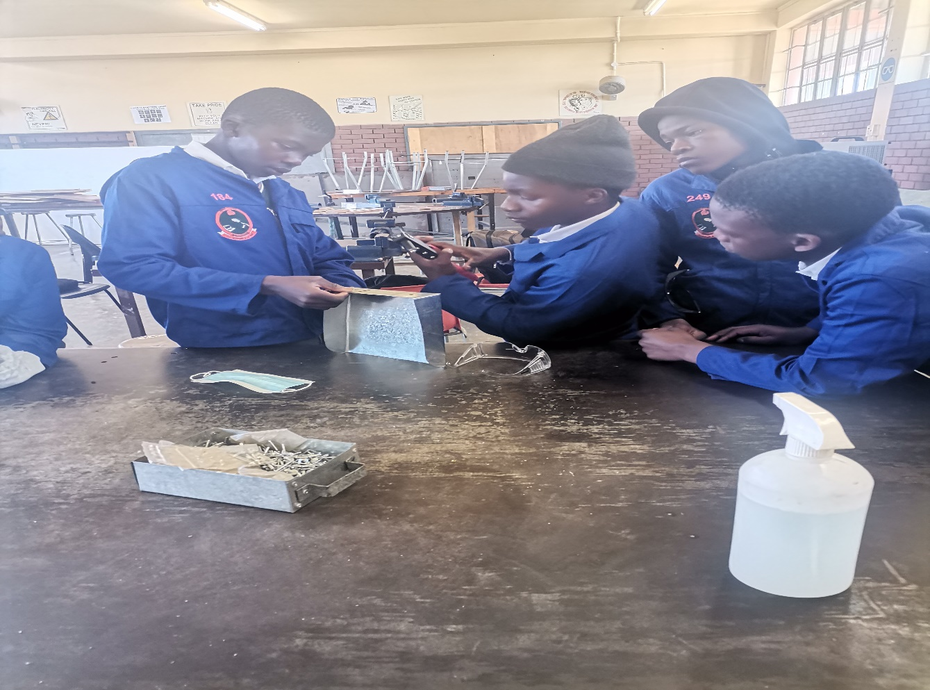
Feedback :Activity
(Practical lesson or Project)
SCOOP

